Slide 1
COLOR GUARD & GUIDON PROCEDURES

Slide 2
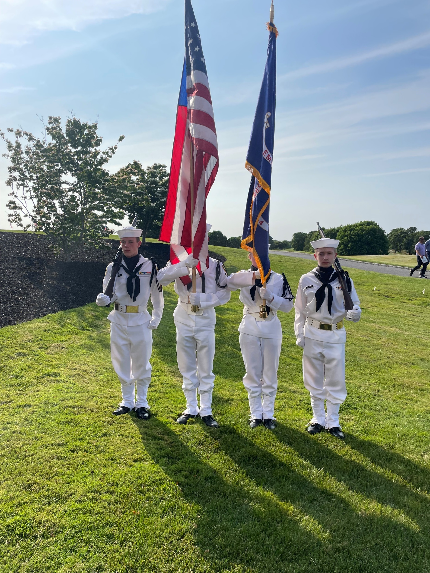
Military color guard A uniformed Active Duty, National Guard, or Reserve color guard made up of a minimum of four members. This then extends to all Veteran Service Organizations, First Responders, ROTC and JROTC cadets, Scouts, Explorers, and any other uniformed military or paramilitary organization. Flag, Colors, or Color. Different terms for the same thing. American, US, Ensign, National Ensign. Terms for the American flag. Color Guard and Color Team can be used interchangeably. https://www.youtube.com/watch?v=wruVvFOr3OQ

Slide 4
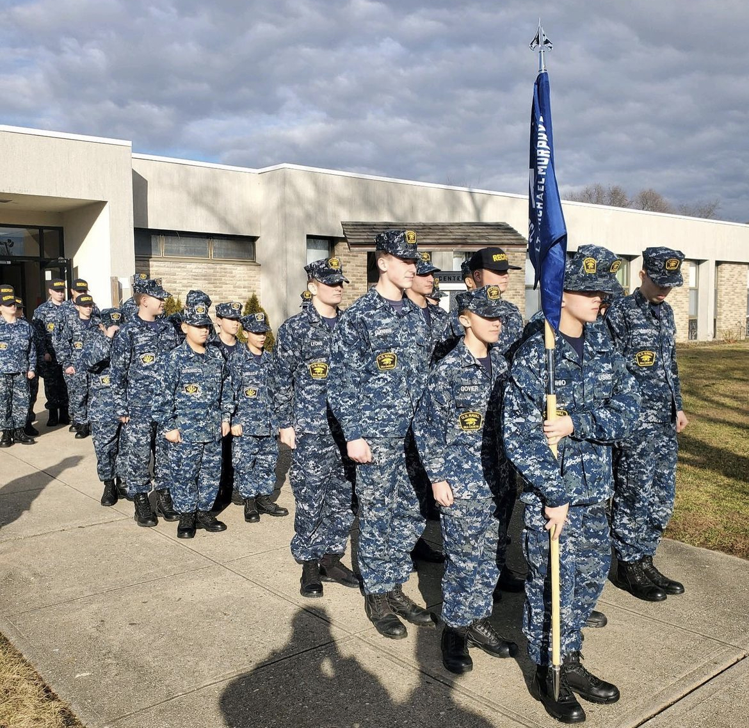
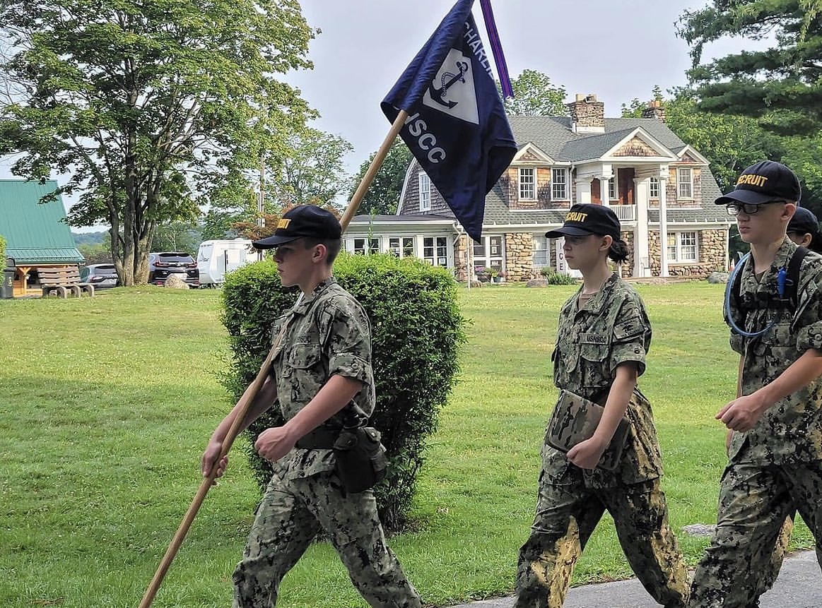
The Guidon
Military service color guards use the two-piece light ash wood guidon flagstaff with a ferrule at each end. Metal staffs are not authorized.
Organizational flag: 3 feet by 4 feet, mounted on an 8-foot staff. Battle streamers are not authorized on this staff/flag.
Ceremonial flag: 4 feet 4 inches by 5 feet 6 inches mounted on a 9- or 9.5-foot staff. Battle streamers are authorized on this size flag and staff, but may not be authorized for your unit to carry. Check your specific manuals.
.

Slide 5
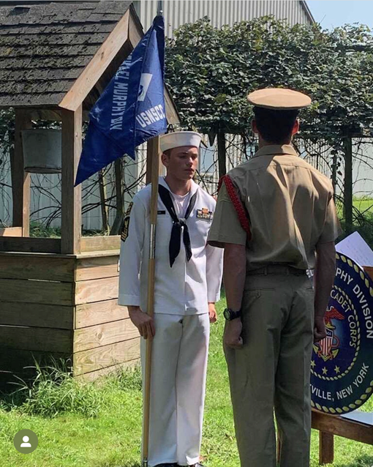
Guidon Parts Only Light ash guidon is authorized NO DARK BROWN WOOD GUIDONS! NO Metal Poles

Slide 7
Guidon Grips
Taco Grip or V grip
Strong grip

Slide 8
Flag Staff Nomenclature

Slide 9
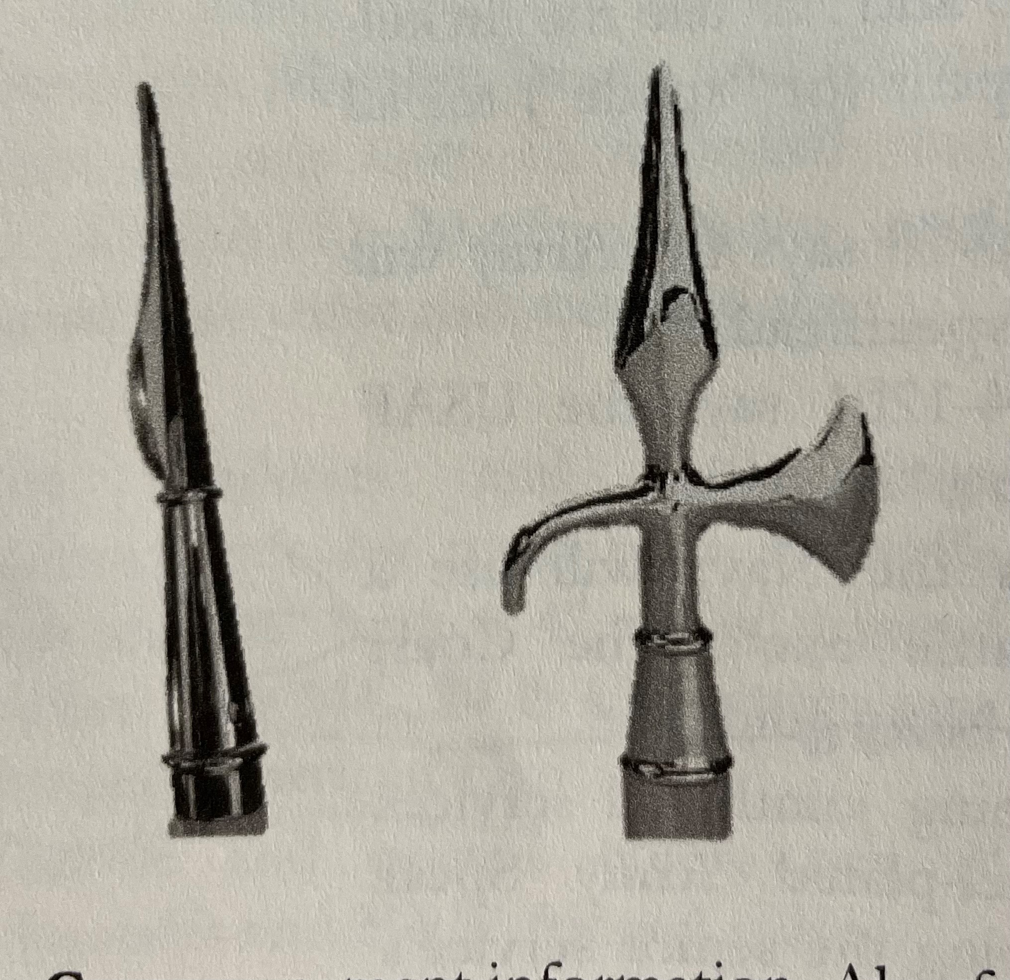
Flag Staff Ornament Finial
Navy Regulations state the Flag staff Ornament must be a Gold Battle axe or spade. Never use a “spread eagle” it is only for the President of the United States only!!!
Battle Axe
Always faces forward when in Carry and Order
Army Spade
Back Flat when in Carry and Order.

Slide 10
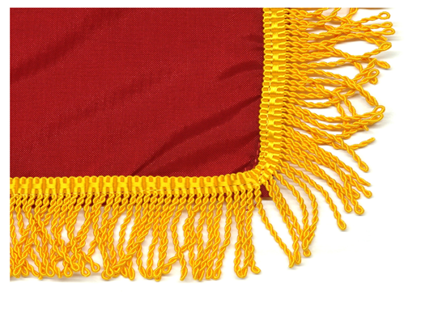
Flag Fringe The Marine Corps, Navy, and Coast Guard have gold-colored fringe on all flags except for the American flag at all times. NO FRINGE ON THE AMERICAN FLAG. LMMD Flag may have fringe!!
Fringe

Slide 11
Order Guidon

Slide 12
Carry Guidon

Slide 13
Guidon Carry Double Time

Slide 14
Guidon Salute
This salute is only used not in formation!!
Example: When a guidon bearer is not in a formation (either walking somewhere or standing and holding the guidon) and is approached by an officer, there is only one authorized salute, which is different from the salute pictured above. This salute is not authorized while in formation.

Slide 15
Guidon Parade Rest

Slide 16
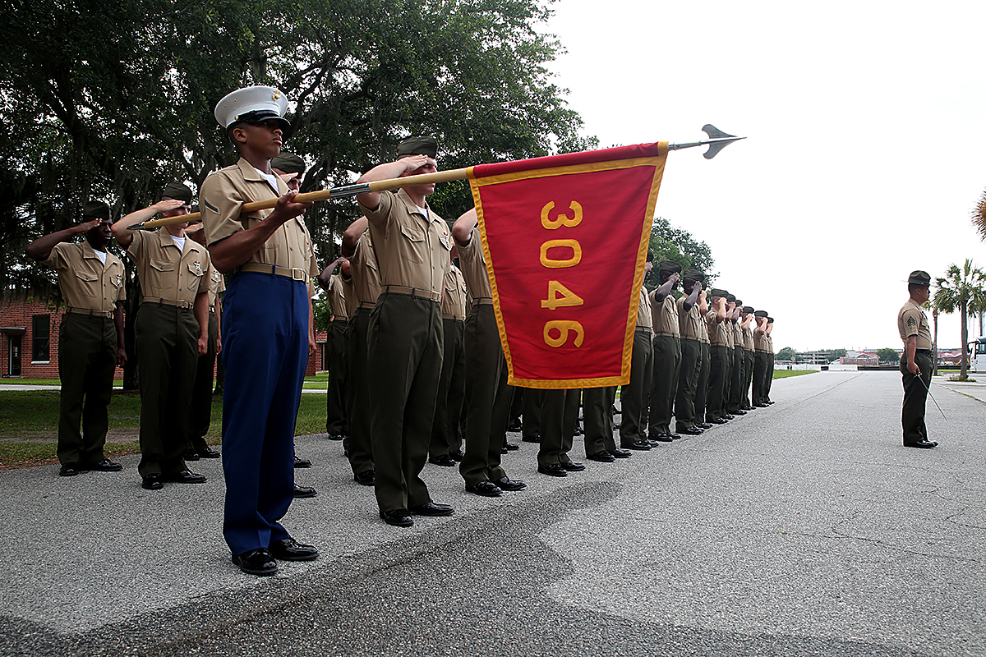
Guidon Salute in Formation or Marching in Formation

Slide 17
Guidon Movements
https://www.youtube.com/watch?v=Uteflg9wPj4
https://www.youtube.com/watch?v=V9vyVxT_s6Q
Retire the Guidon USMC
https://www.youtube.com/watch?v=33WvWWUjTTw

Slide 18
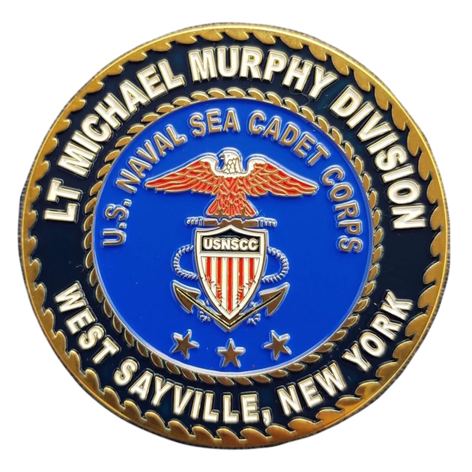
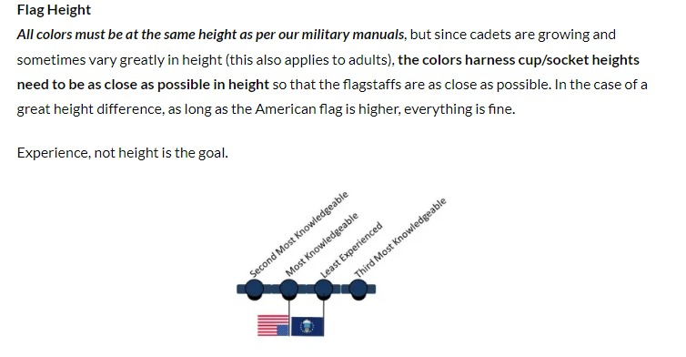
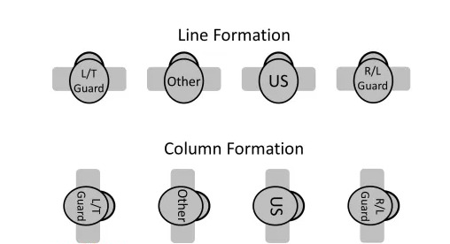
Color Guard Formation
The minimum standard for all services. You must carry the US and your service’s departmental colors. Color guards are not authorized to replace the departmental flag at any time with any other flag. The image below is called Line Formation, members abreast. TC 3-21.5, MCO P5060.2, and AFMAN 36-2203.
he minimum color guard authorized for Air Force and Air Force-related units.
Note: this three-man team is not standard, but may be used in certain circumstances. Try to use a full 4-person team at all times. National Ensign or American flag will always be on right of the column or observers left.

Slide 20
When Standing at attention this is how you hold the Colors. Notice the colors at trimmed under the arm of the color guard bearer.

Slide 21
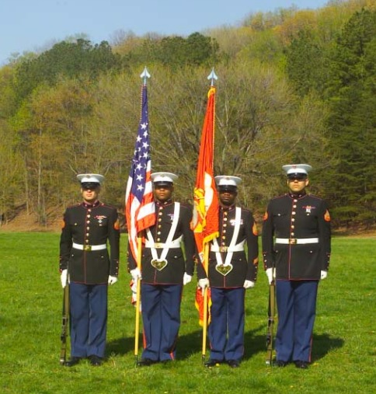
Color Guard Order Colors
ORDER COLORS
At order colors, the lower ferrule rests on the deck touching the outside edge of the right shoe.
The staff is gripped in a strong grip with the thumb wrapped around the front of the staff with the fingers wrapped to the rear.
The right elbow is held close to the side so the forearm will help support the staff.
The upper staff rests in the hollow of the right shoulder. The staff is vertical with the flat side of the spearhead facing front. The color bearer is at attention.

Slide 22
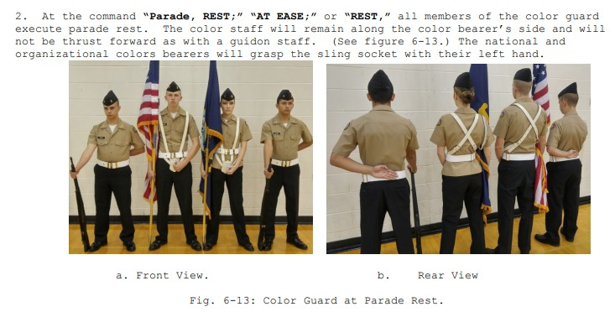
Color Guard Parade Rest

Slide 23
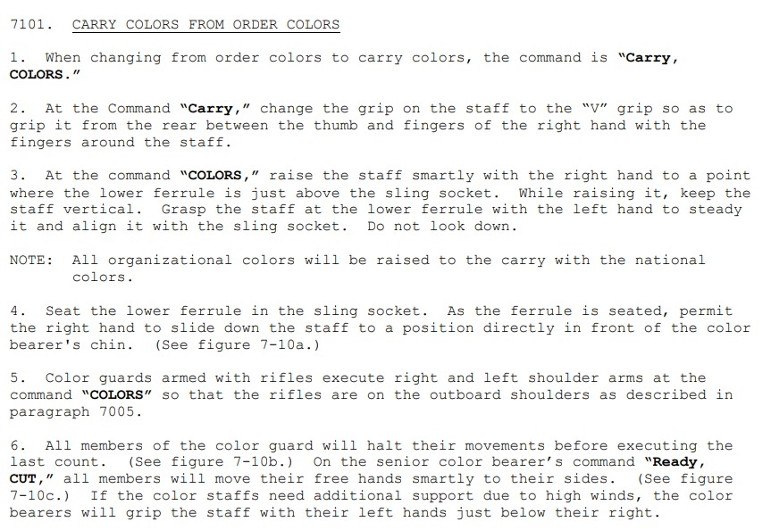
Carry Color from Order Colors
Raising Staff Seating the Ferrule

Slide 24
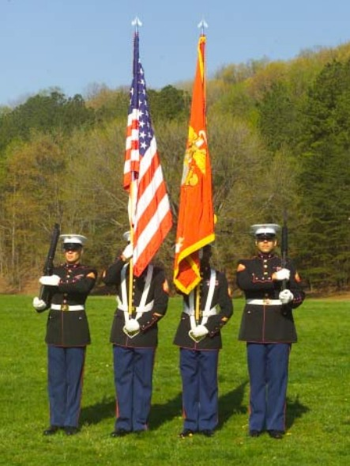
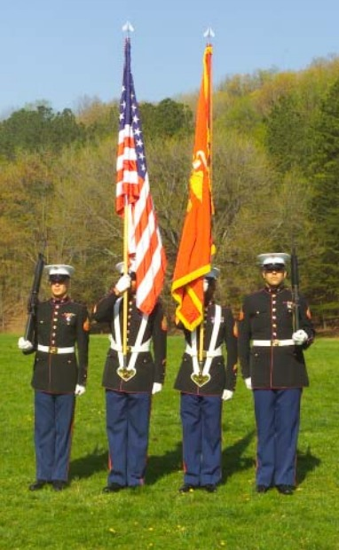
Color Guard Carry Colors
Movement after raising flagstaff last Count
Carry Colors final position

Slide 25
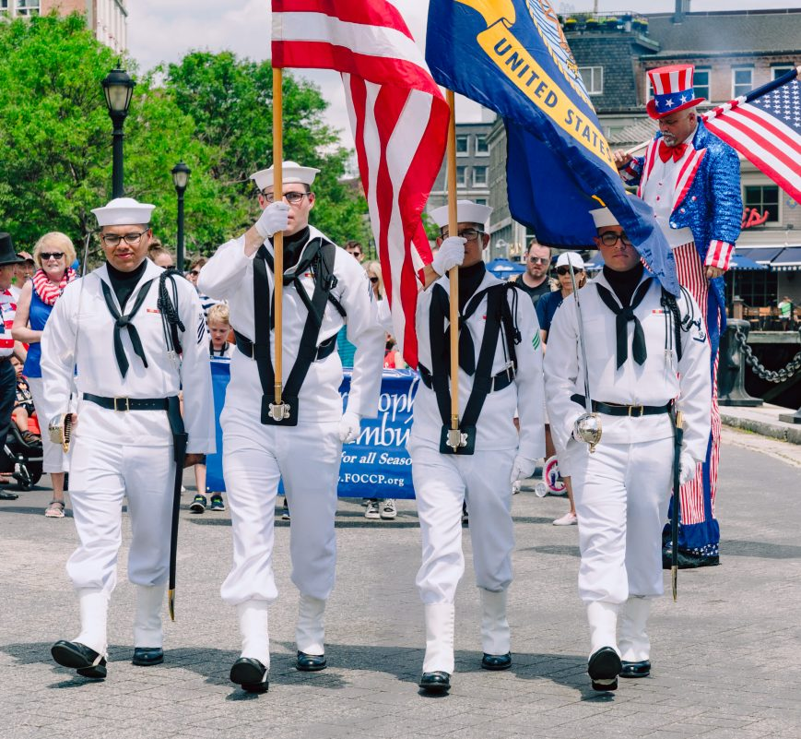
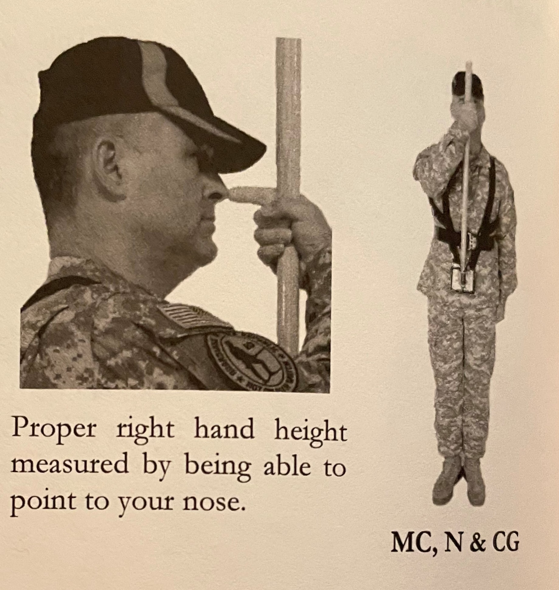
Color Guard Carry Colors
Notice Hand position for Flag staff guards. Hand holding staff align with your mouth. Your index finger should be able to touch your nose for required length. Opposite hand at attention on seem of pants.

Slide 26
Order Colors to Carry Colors

Slide 27
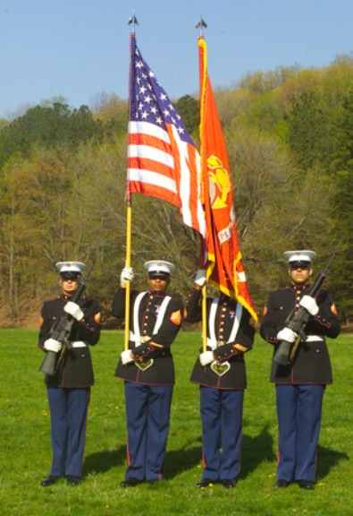
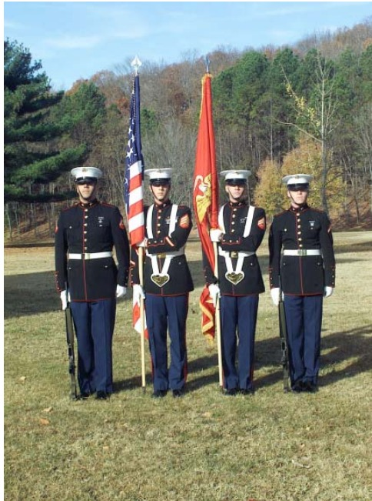
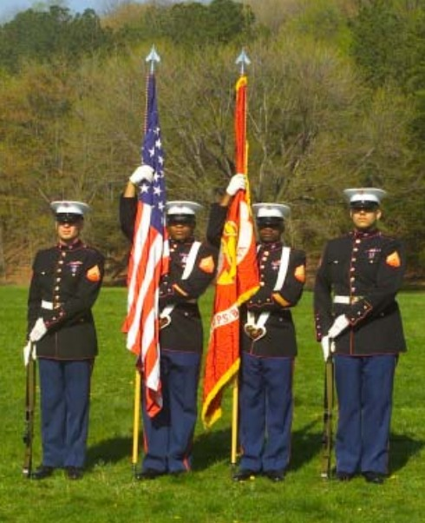
Color Guard Order Colors from Carry Colors
Removing the Ferrule
Lowering the Staff
Trimming the Colors

Slide 28
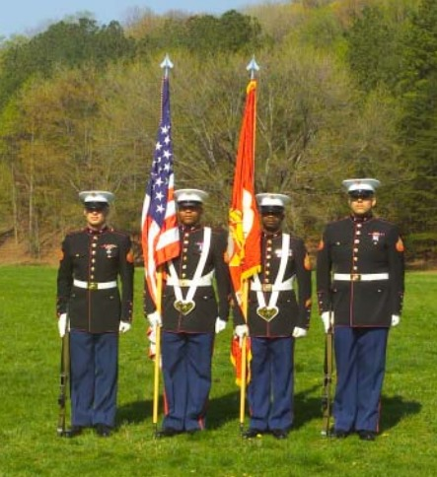
Trim the Colors Movement Complete
Trimming the Colors
Movement Complete

Slide 29
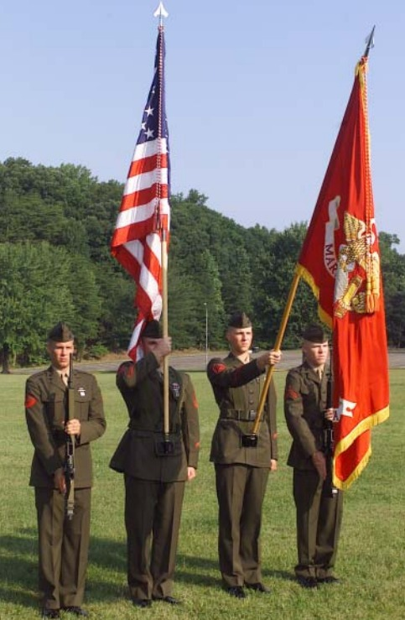
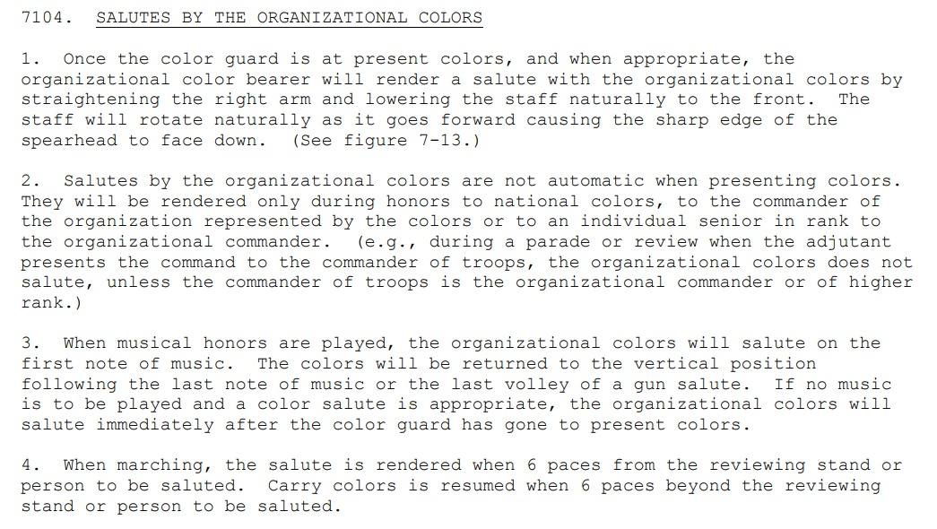
Color Guard Salutes

Slide 30
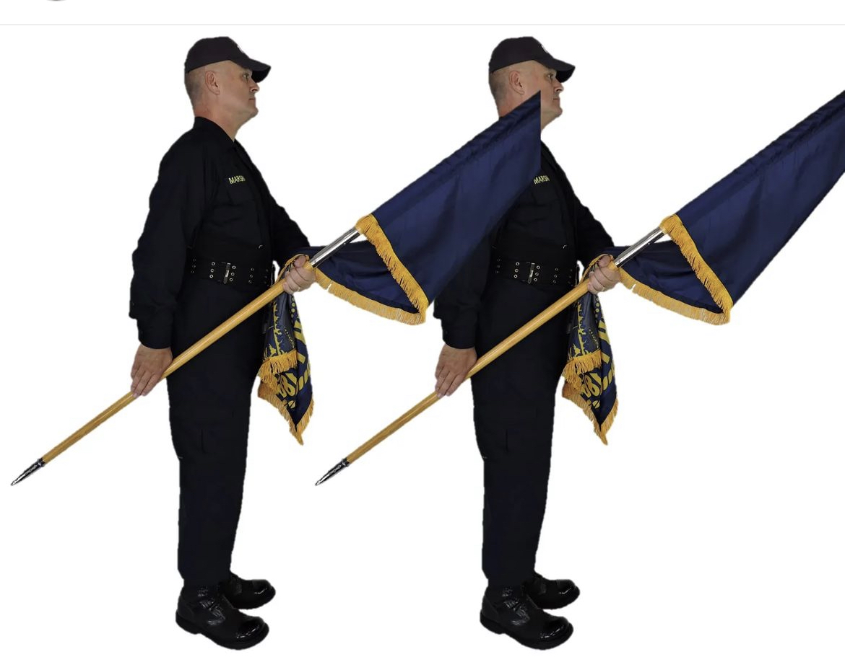
Angle Port Used to carry in low ceiling and moving in formation. The flag rests on the arm of the wear

Slide 31
IMPORTANT TIPS
Positions. Do not mix positions! (e.g. color bearers at Order and rifle guards at Port.) If one of the team members is at Carry (Right Shoulder), then all members are. This includes all positions: Order, Port, Trail, etc. The team must look, act, and move as one.
The color guard is formed and marches in one rank at close interval with the color bearers in the center. While marching, members of the color guard do not swing their free arms.
DON’T SIMILE !!!
Many a photographer, seeing a color guard standing in column for formation, has approached the team from the right side and asked the team to turn right for a picture. Don’t do it! This puts the American flag to the left of the other flag(s) and the team is then immortalized for setting up incorrectly. Members of the team must know better and ask the photographer to take the picture from a more appropriate position.
POW flag is never to be carried in color guard it is only to be flown on flag pole or displayed not held
Spats are not authorized just leggings for boots

Slide 32
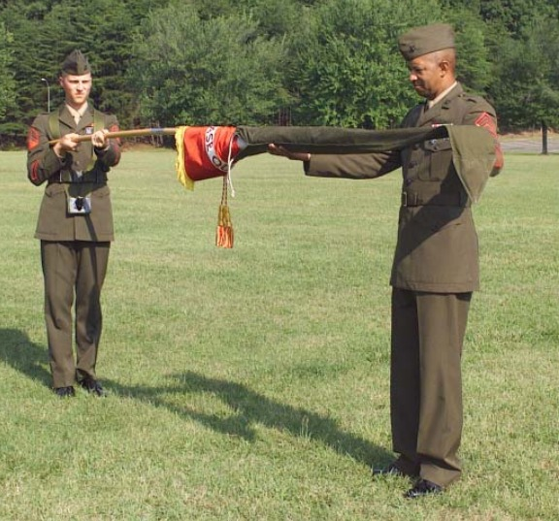
Uncasing the Colors
To uncase the colors, the color guard will be formed at carry colors. First the national color bearer and then the organizational color bearer will lower their staffs so that the cases may be removed. The individual(s) removing the cases will then step back and salute the national colors before retiring.

Slide 33
Casing the Colors
To case the colors, the color guard will be formed at carry colors. The individual(s) with the cases will center on the color guard and salute the national colors. The organizational color bearer followed by the national color bearer will
lower their staffs so that their colors may be furled and cased. Rather than wrapping the colors around the staff, the colors should be folded on top of the staffs and held until the cases are slipped on. The rope and tassel and streamers,
if any, are kept clear until the colors are folded onto the staff, and then are placed as flat as possible. Care should be taken to ensure that color cases fit easily over the colors. Cases constructed with too narrow of a diameter cause
undue wrinkling and may even damage the colors.

Slide 34
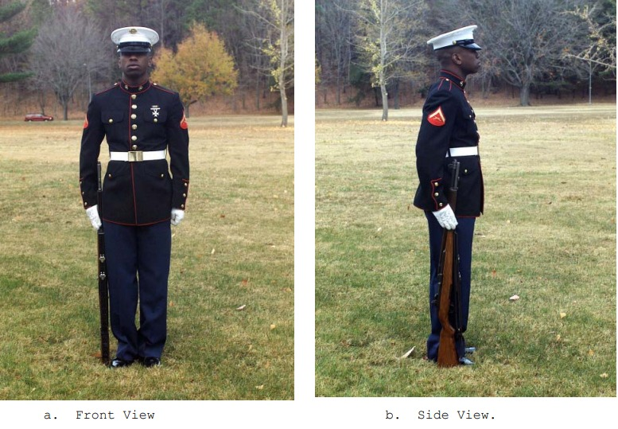
Rifle Order Arms
ORDER ARMS
When halted, come to order arms when any of the following commands are given: “Squad (Platoon or Company), ATTENTION; FALL IN; or Order, ARMS.” At the command of execution, place the butt on the deck along the outer edge of the right shoe. The toe of the butt is on line with the toe of the shoe. The rifle’s upper hand guard rests in a “V” formed by your thumb and forefinger. All fingers are straight and joined. Your right hand and arm are behind the rifle. This may cause a slight bend in your elbow. The tips of your thumb and forefinger are kept on line with the open edge of the upper hand guard. Your right thumb should also be along the trouser seam. Except for your right hand, the entire body is at attention.

Slide 35
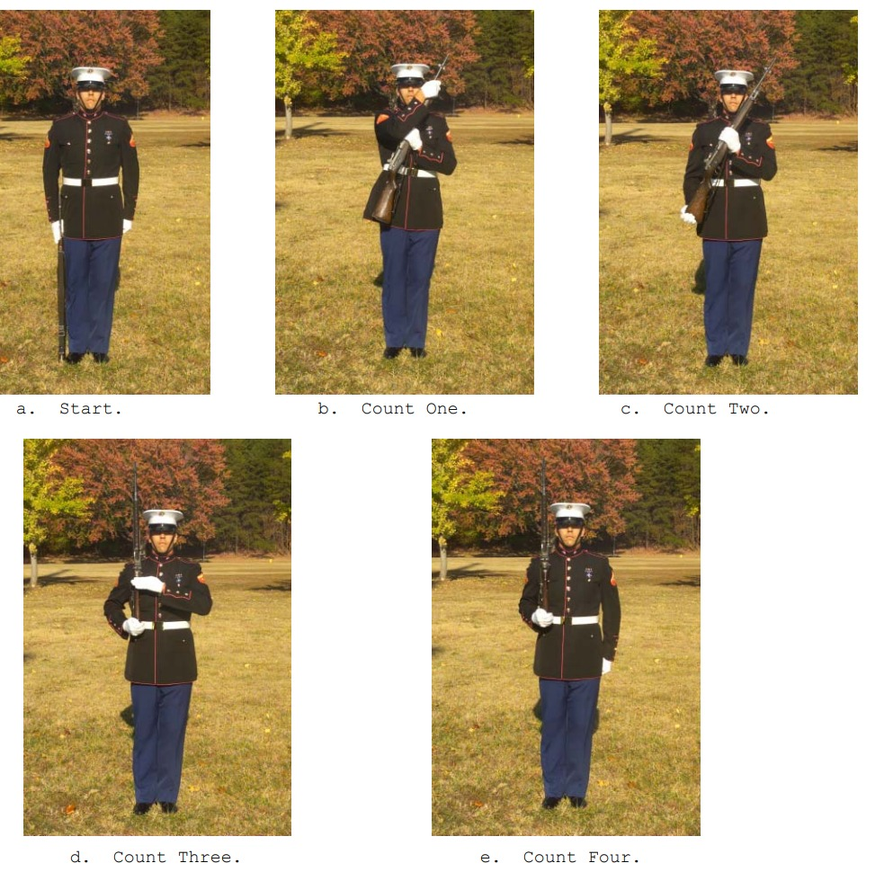
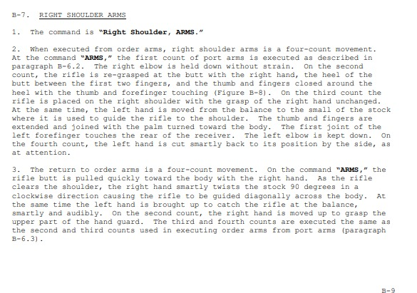
Rifle Shoulder Arms

Slide 36
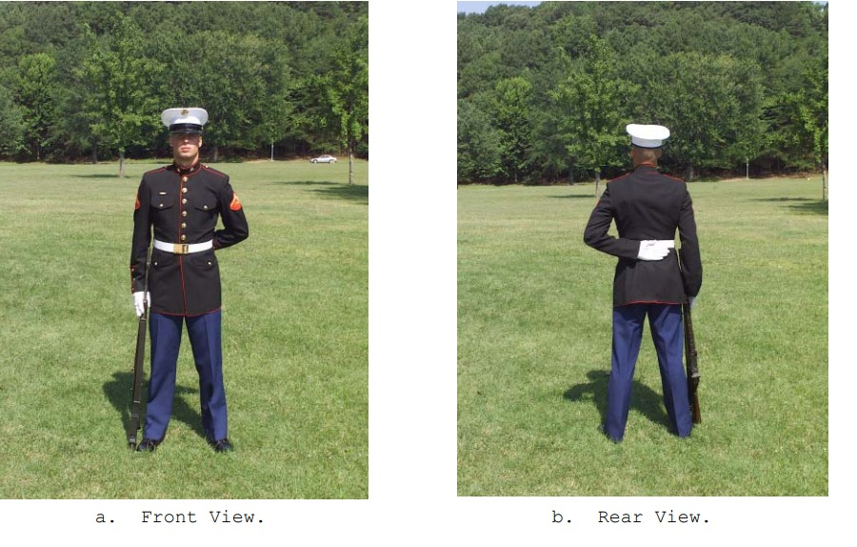
Rifle Parade Rest

Slide 37
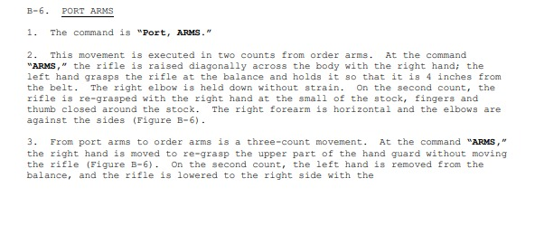
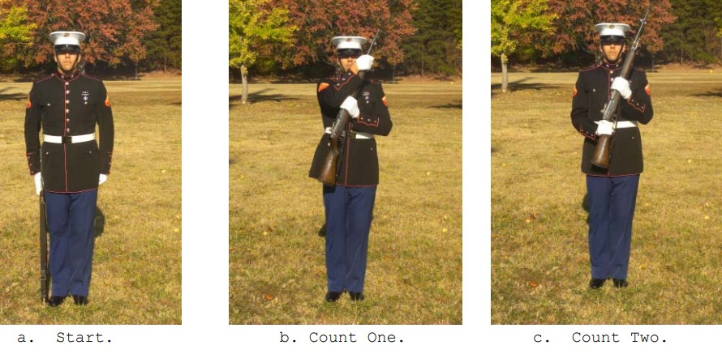
Rifle Order Arms & Port Arms

Slide 38
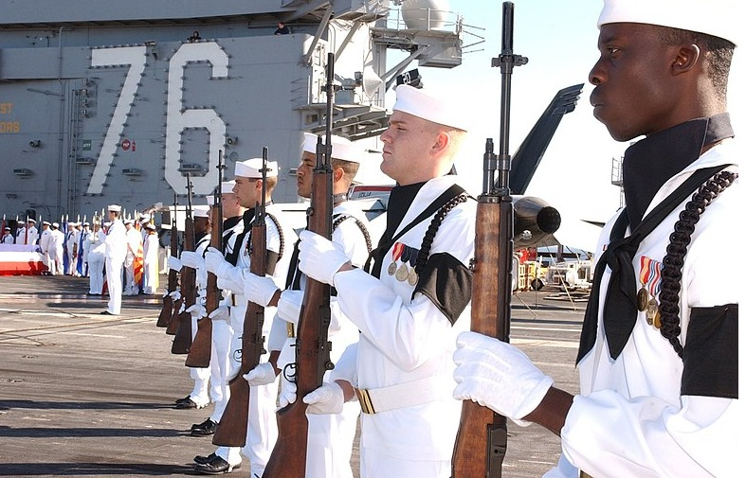
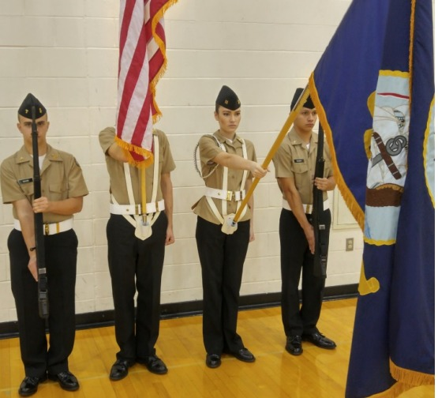
Color Guard Present Arms

Slide 39
Posting the Colors

Slide 40
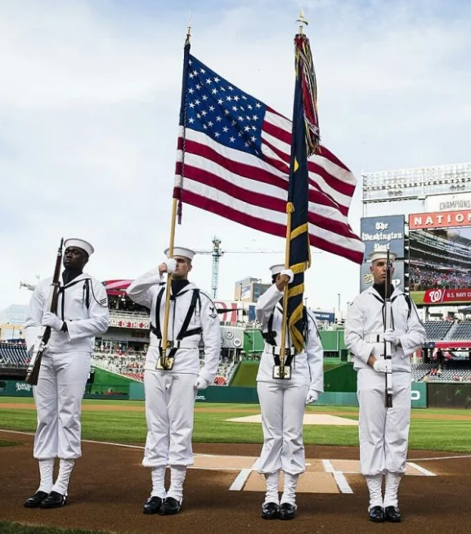
Color Guard Gear
Harness
Ascot-scarf bib
Aiguillette
Gloves
Leggings

Slide 41
Color Guard Harness

Slide 42
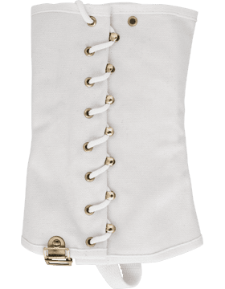
Leggings
These US Navy ceremonial & Parade leggings feature a white canvas fabric with brass hardware. They are available in two adjustable sizes. These leggings are used by ceremonial Color and Honor guard members of the US Navy and meet US Navy uniform regulations.

Slide 43
Spats are not approved per Navy regulations!!!

Slide 44
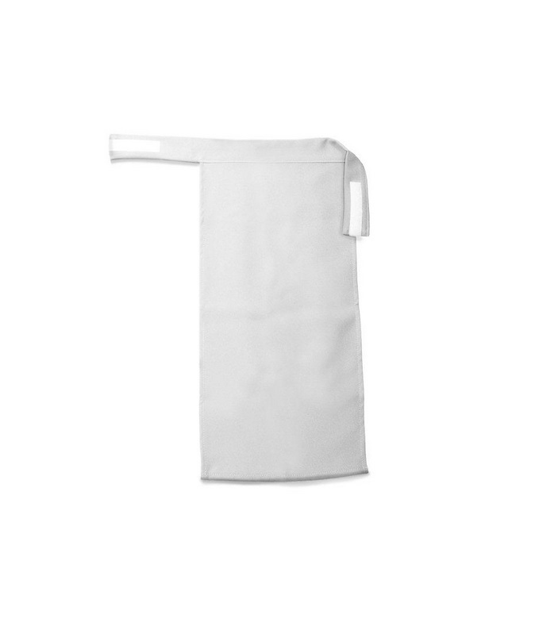
Ascots

Slide 45
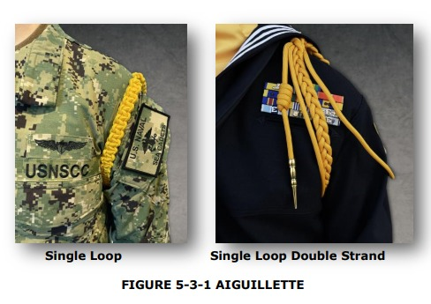
Aiguillette

Slide 46
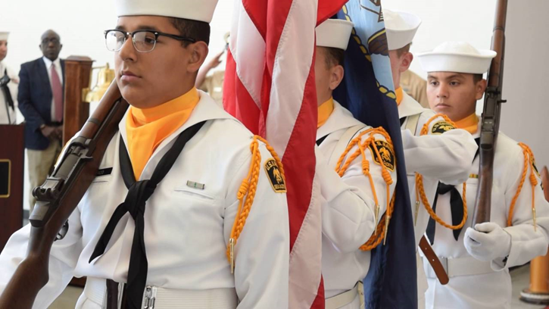

Slide 47
Gloves

Slide 48
What's wrong with this photo?

Slide 49
What's wrong with this photo?

Slide 50
What's wrong with this photo?

Slide 51
What's wrong with this photo?

Slide 52
What’s wrong with this photo?

Slide 53
What's wrong with this photo?

Slide 54
Answer: X -staffs must be vertical X- right rifle guard foreman must be horizontal X-left hand on staffs must be touching right X-grips on rife must have all fingers together

Slide 55
Color Guard Videos
The U.S. Navy Ceremonial Guard performs Colors for the National Anthem
https://youtu.be/zcmBSdyNom4
Color Guard at the 2022 NJROTC National Academic, Athletic, and Drill Competition
https://www.youtube.com/watch?v=fPHOOhRUa7A
Color Guard History
https://www.youtube.com/watch?v=7rHMMnyK-rE

Slide 56
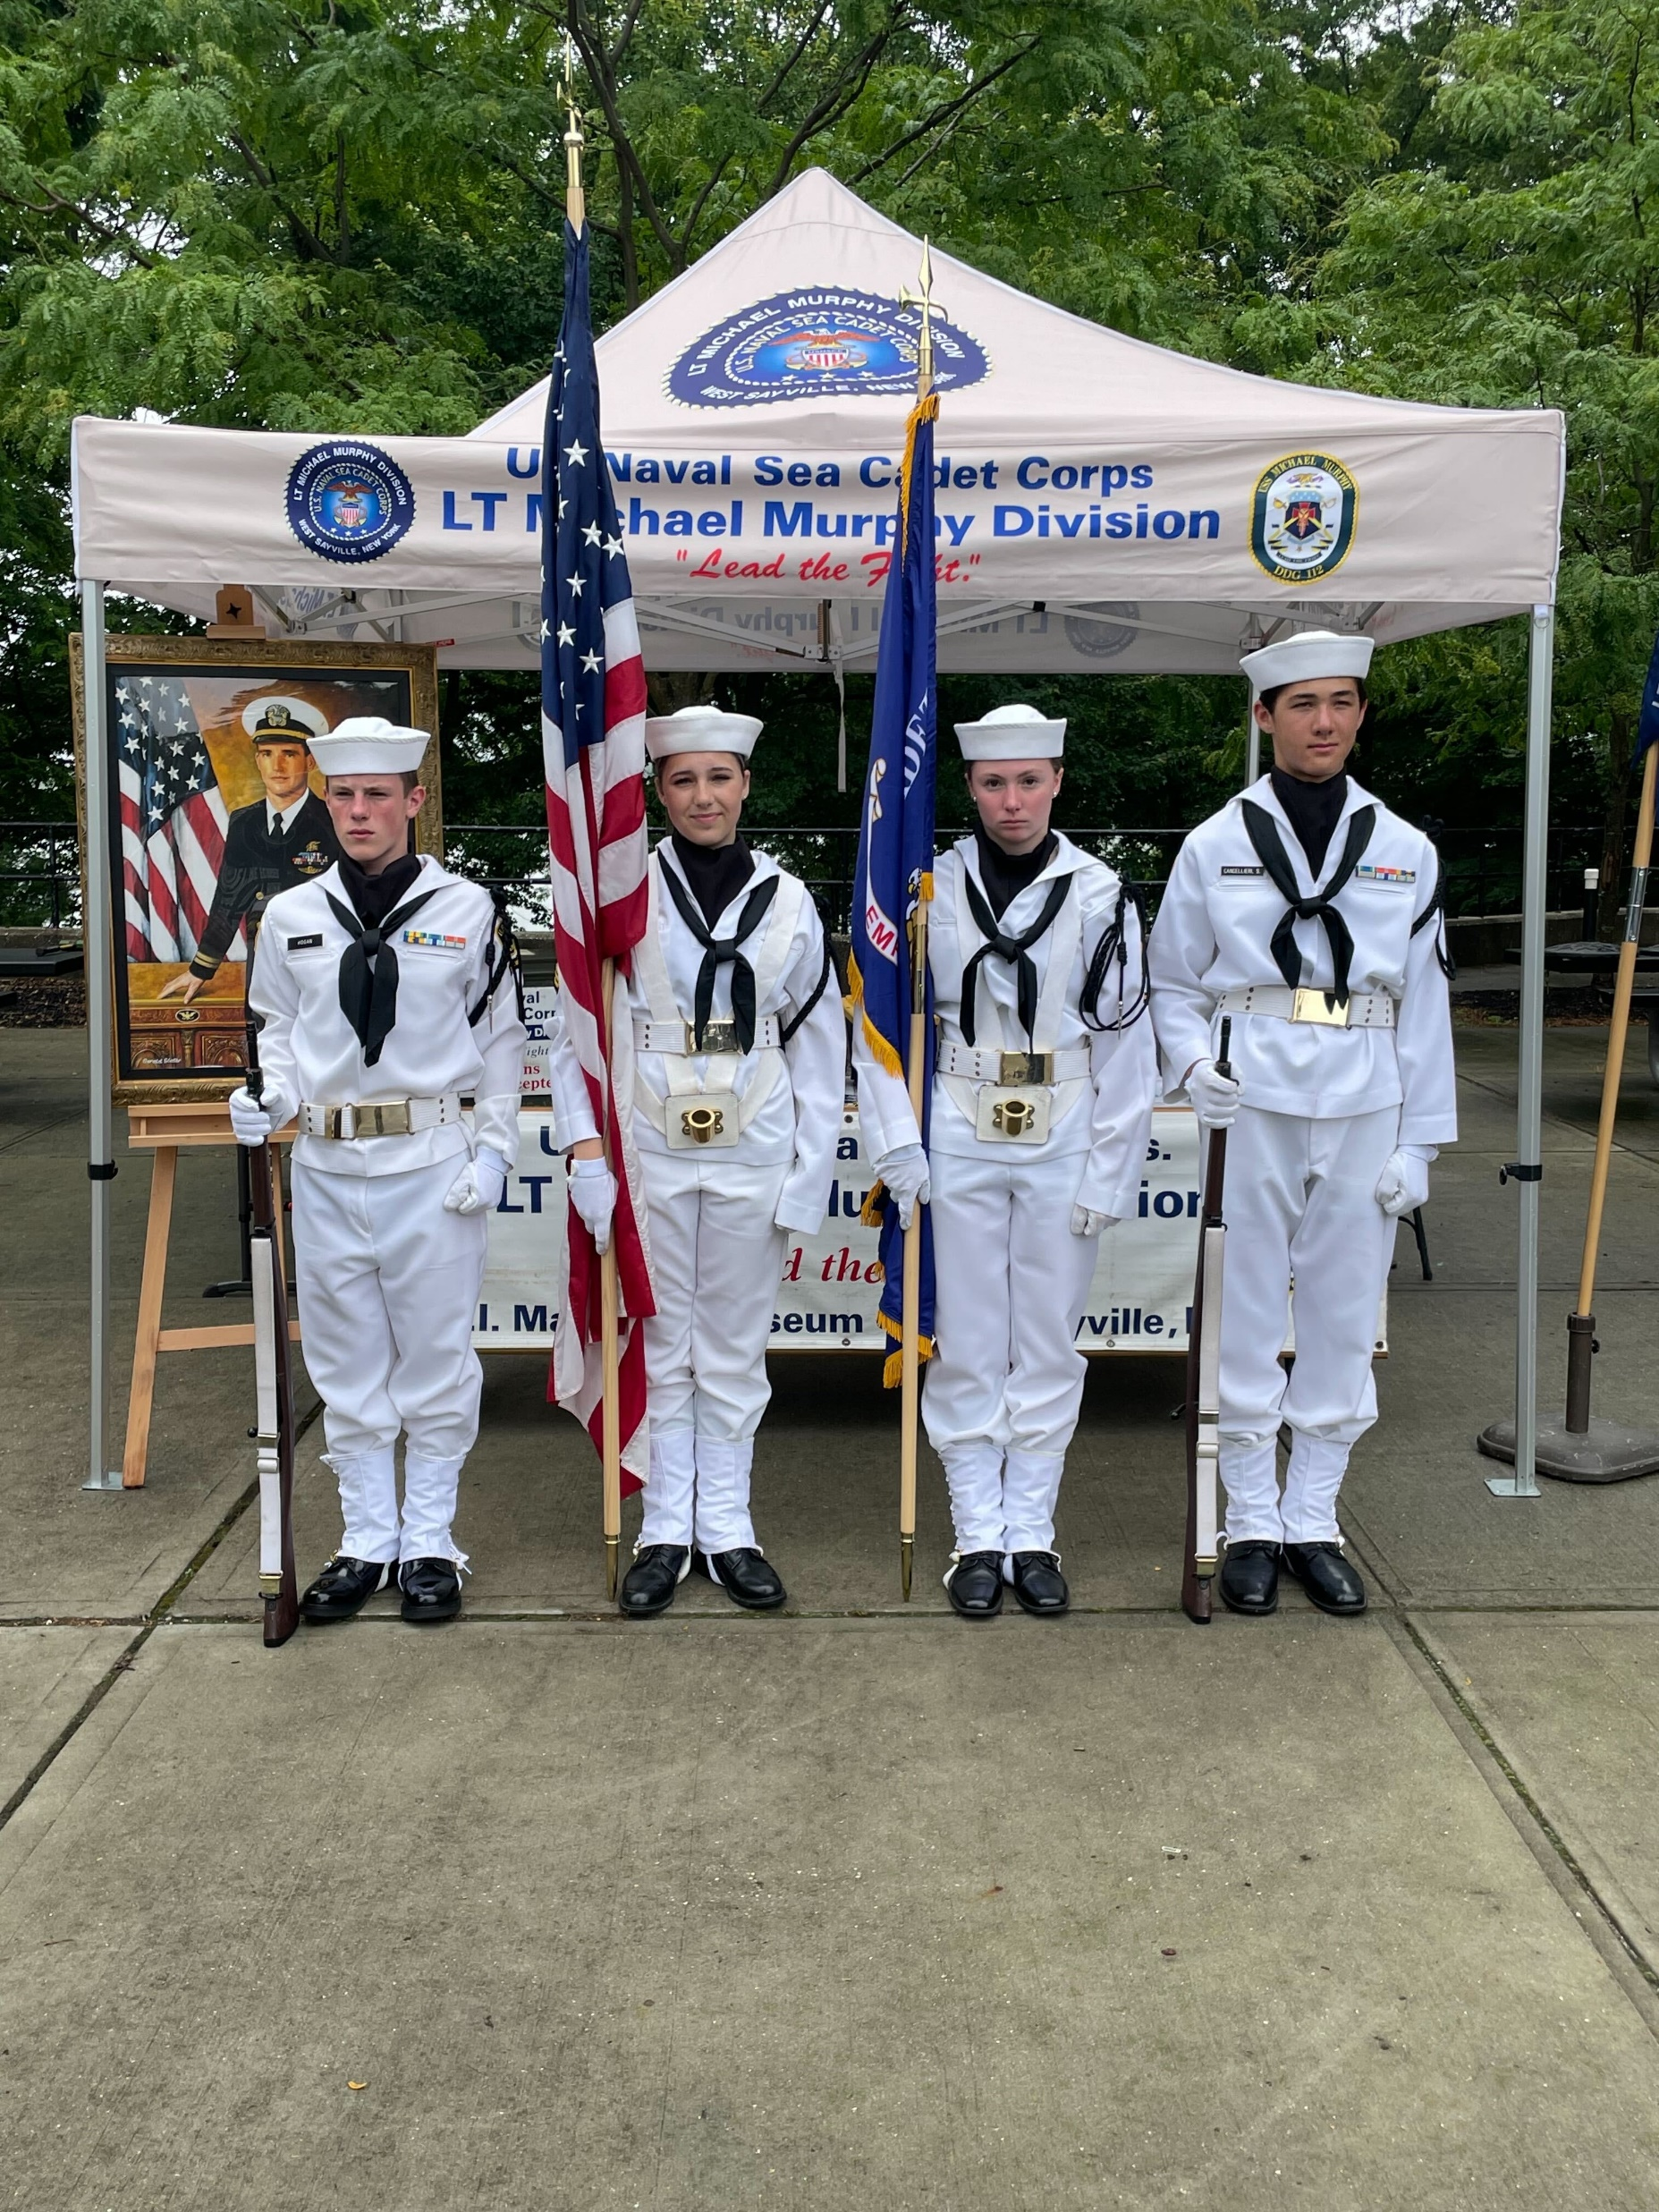
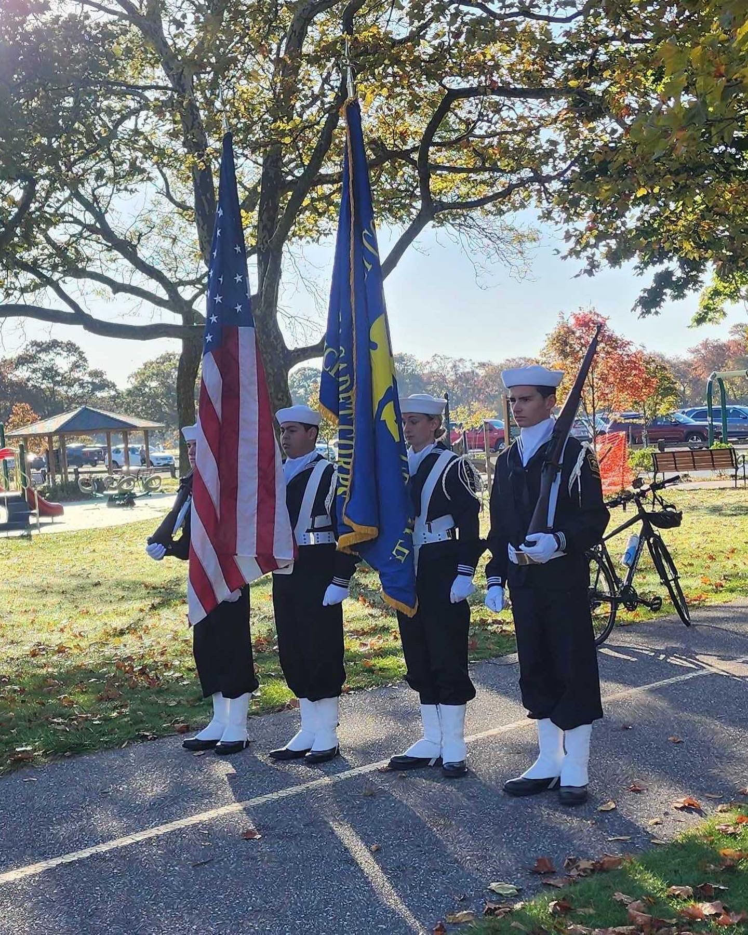
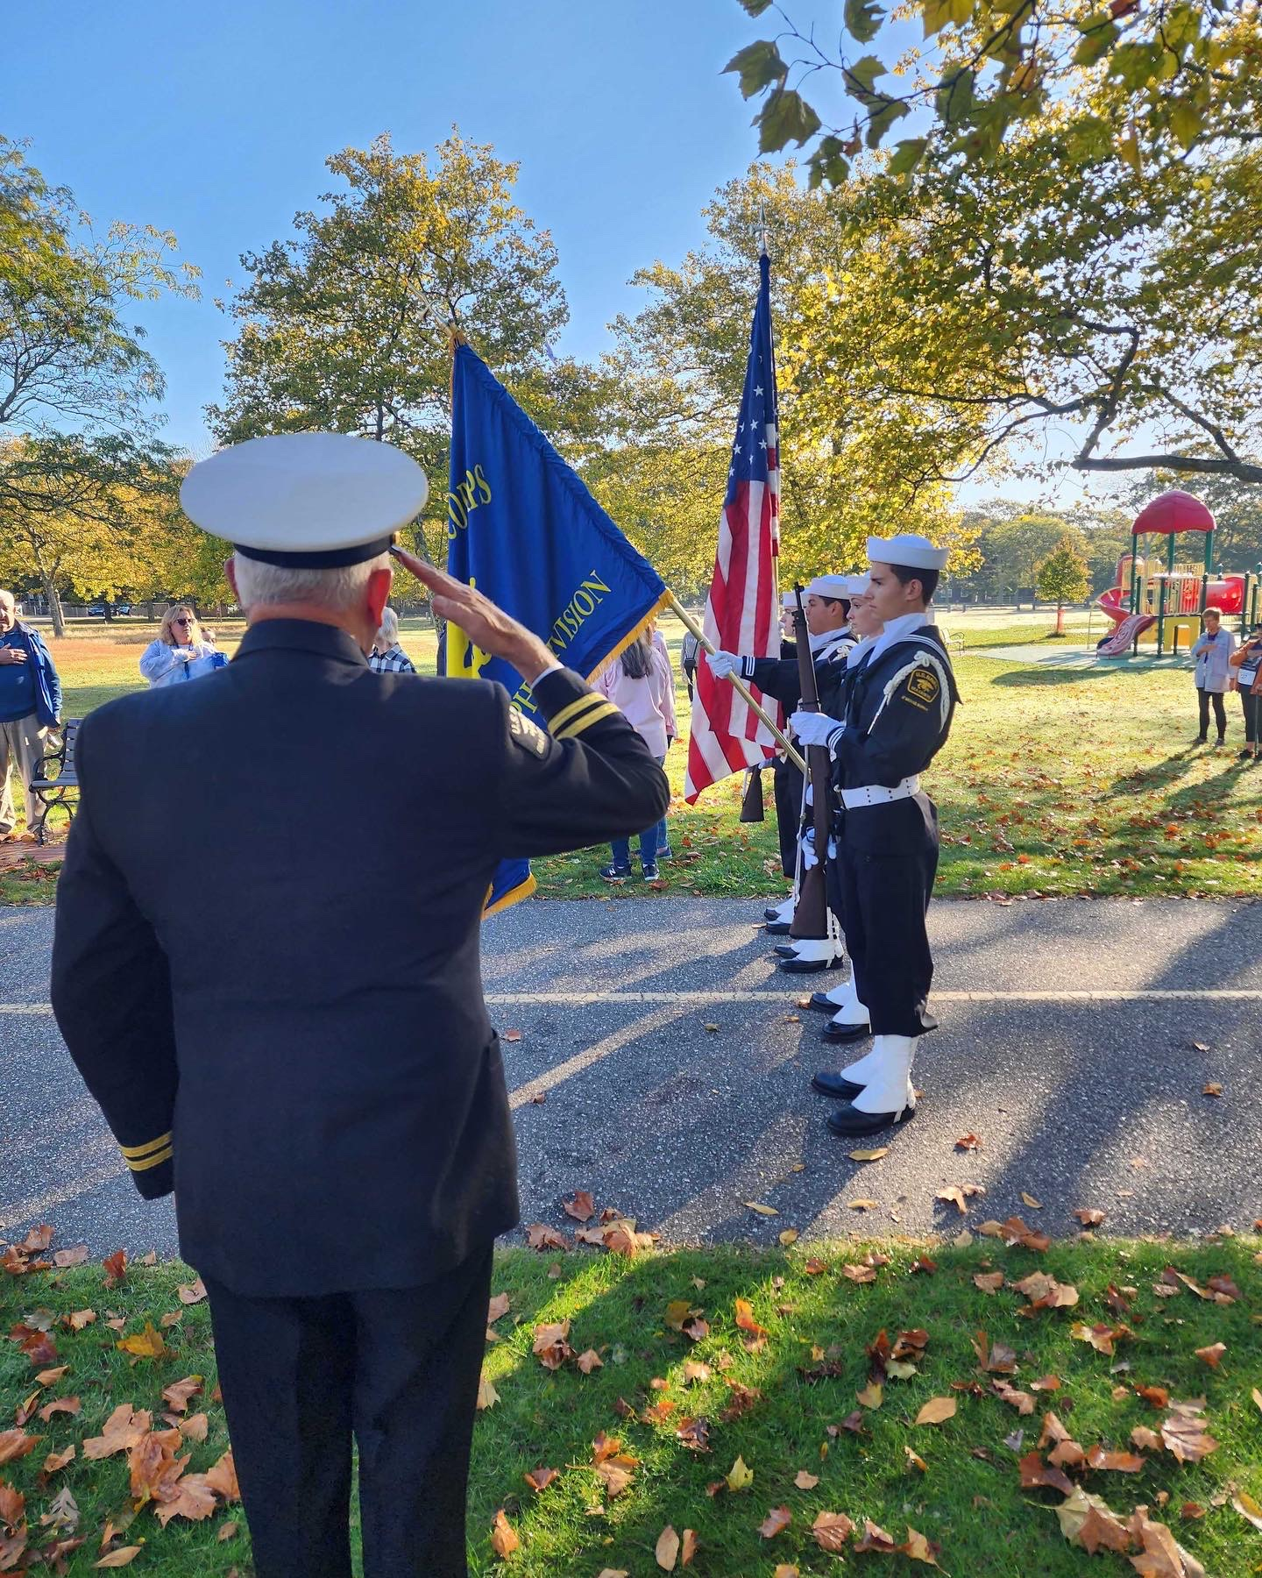
“Lead the Fight”

